Slide 1
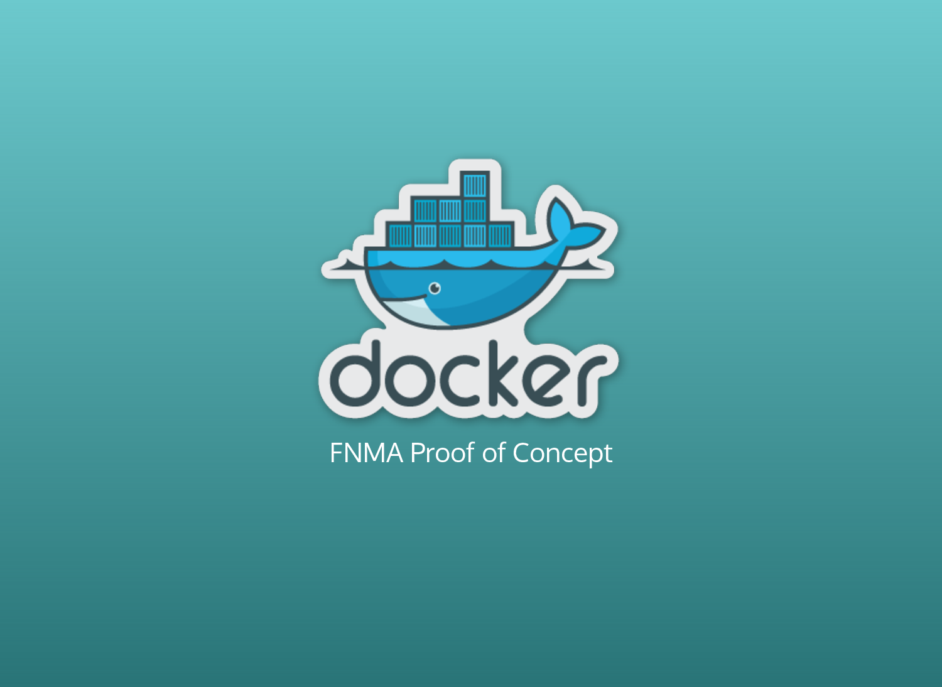


Slide 2
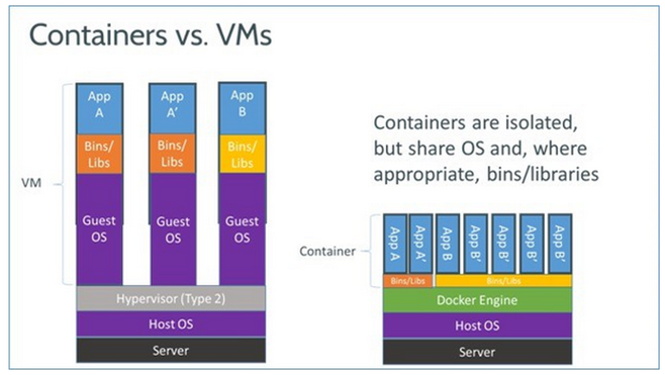
What is Docker

Slide 3
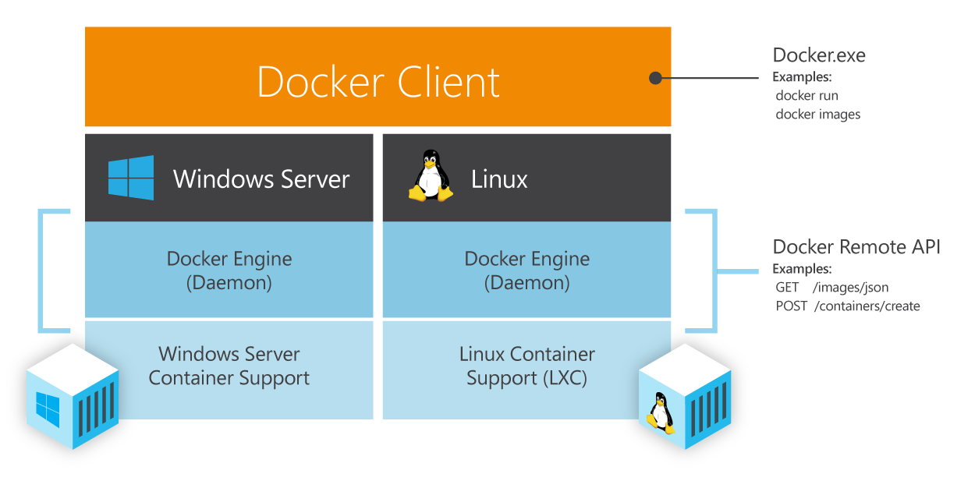
Understanding Docker

Slide 4
Docker Pros……
Docker:
● Is easy to install
● Will run anything, anywhere
● Gives you repeatable builds
● Enables better CI/CD workflows
● Is backed by a strong community
● Will change how we build and ship software

Slide 5
How does Docker work ?
You can build Docker images that hold your applications
You can create Docker containers from those Docker images to run your applications.
You can share those Docker images via Docker Hub or your own registry

Slide 6
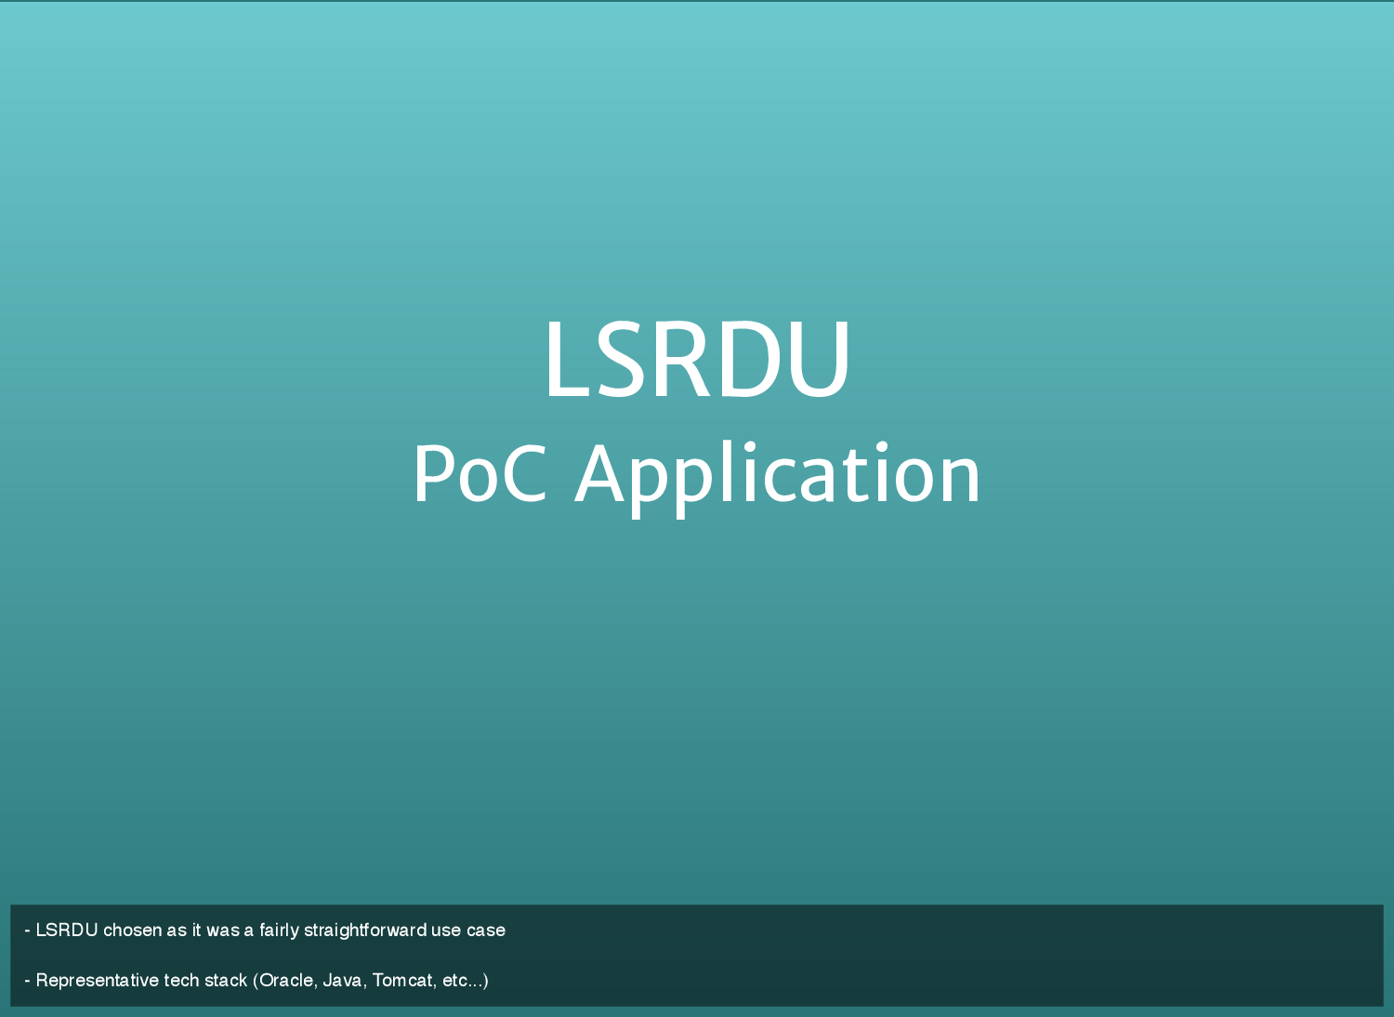

Slide 7
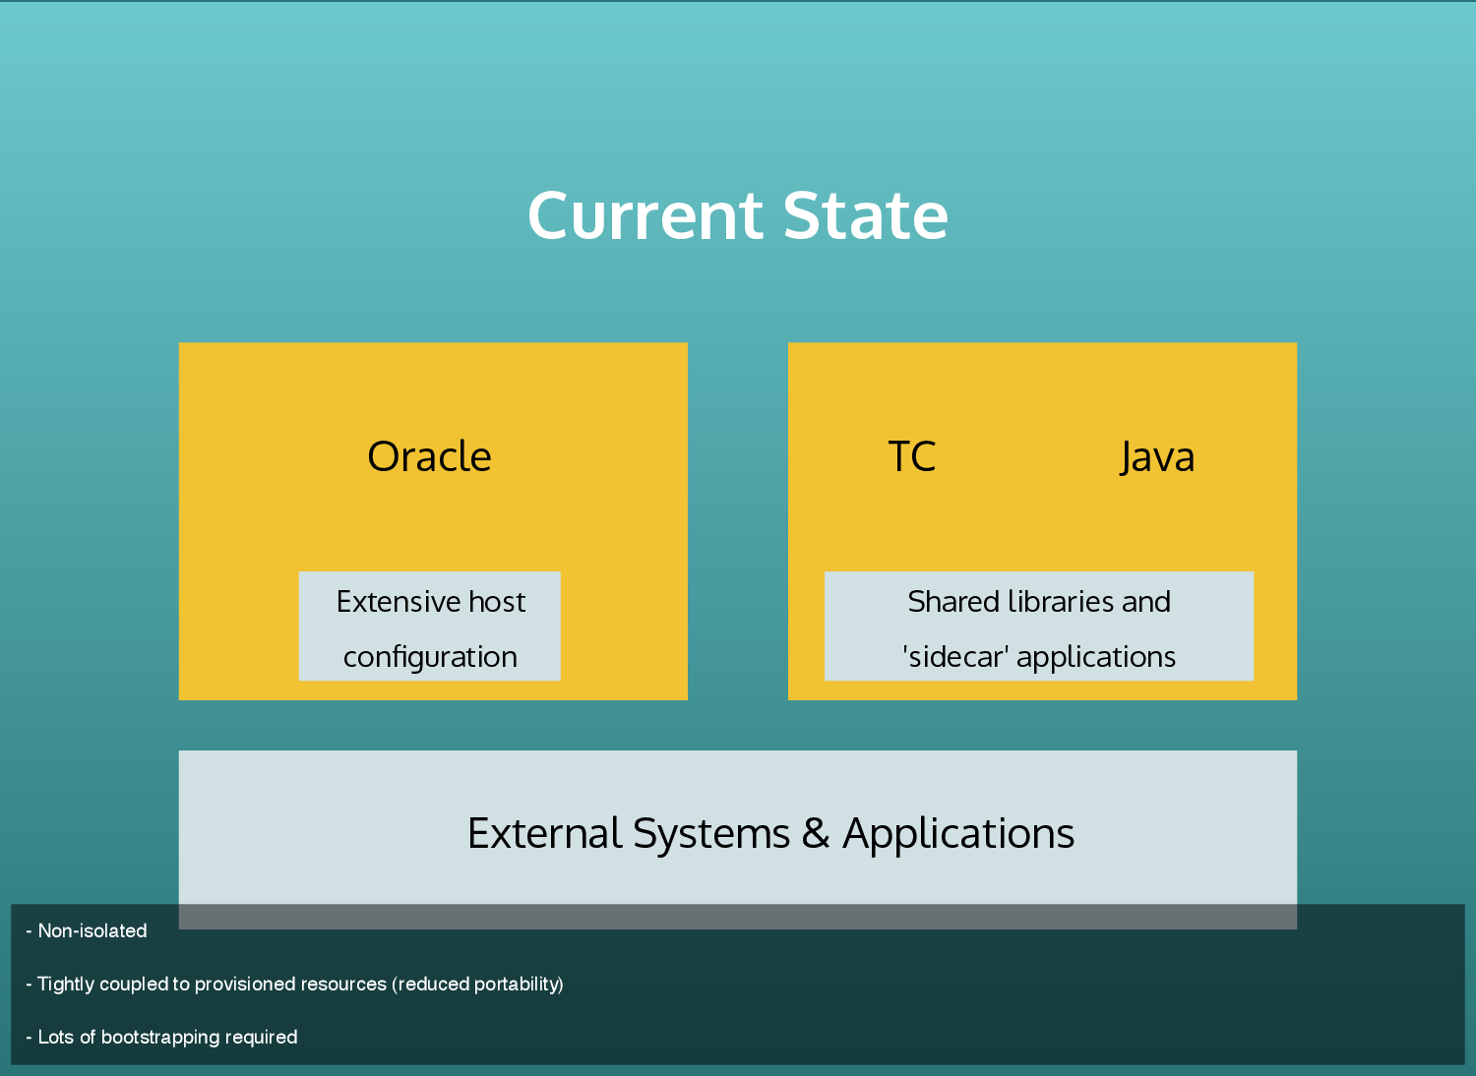

Slide 8
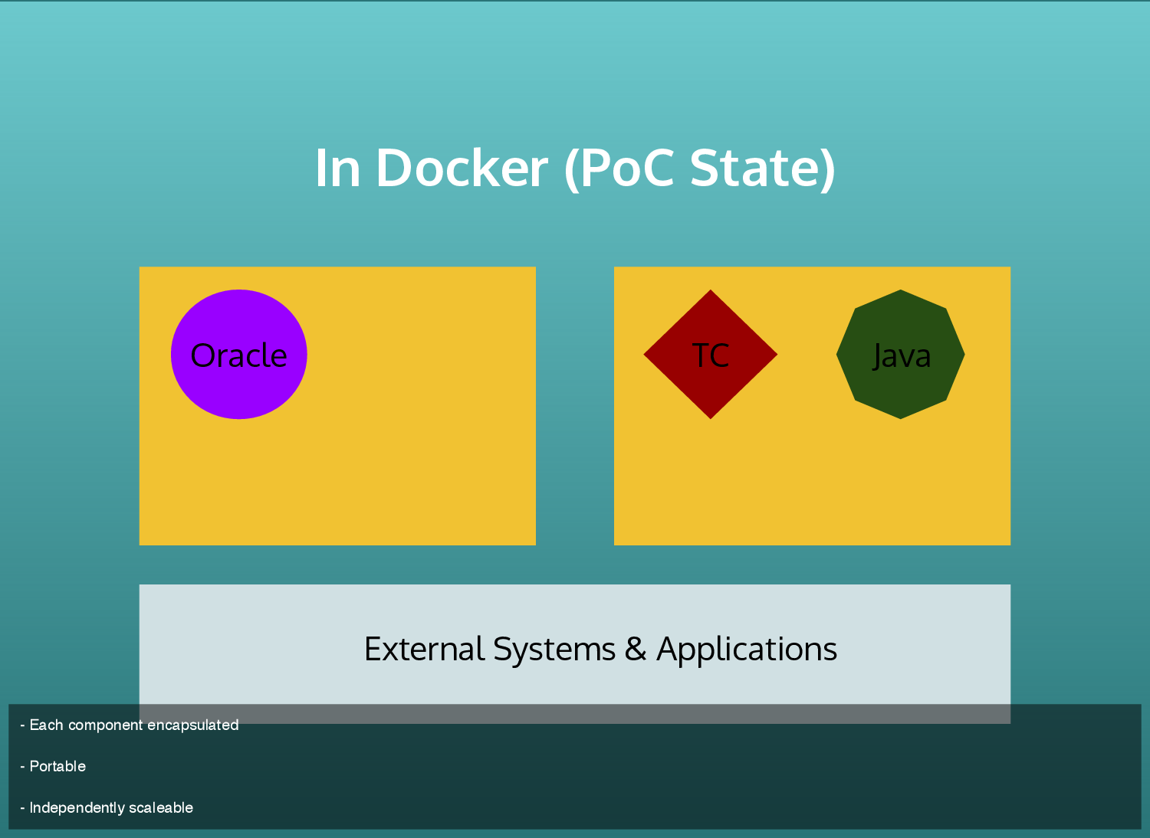

Slide 9

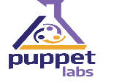






PoC Docker Host provisioning
[RapidIT] Docker Provisioning(vRA7.2/Puppet)
Docker Host VMs
16GB/1TB (ASG?)
Docker Host
Docker Host
Docker Host
Docker Host
NEXUS
JENKINS
Docker Host 1
Docker Host n

Slide 10


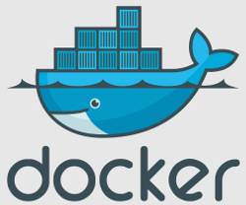
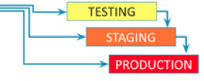

PoC DevOps CICD architecture using Docker
Dockerfile Git commit
Git
Jenkins fetches Dockerfiles from git and Docker images
from Nexus
Jenkins jobs execute docker files by pulling images from nexus
4
App Jenkins calling infra jenkins job to create Docker containers
3
Docker Host
Creation of Docker containers using Dockerfiles .
Multiple Containers include java build , sonarqube with postgres, Selenium grid, tomcat/jboss/weblogic
5
Jenkins fetches Application code from Git
Developers git commit triggers jenkins build job
Docker Images/Build artifacts staged into Nexus
6
Git
2
Sonatype Nexus helps us standardize repository management and categorize them based on environments defined in SDLC.
1
Developer code Git commit

Slide 11
Target DevOps CICD architecture using Docker
Git
1
2
Developers git commit triggers a pull request and jenkins build job
Application code/Docker files Git commit
3
Jenkins jobs execute Docker files by pulling images from Nexus and also builds the application build artifacts
Jenkins fetches Dockerfiles from Git and Docker images
from Nexus
Docker Host
Creation of Docker containers using Dockerfiles .
Multiple Containers include java build , sonarqube with postgres, Selenium grid, tomcat/jboss/weblogic
5
Docker Images/Build artifacts staged into Nexus
4
Sonatype Nexus helps us standardize repository management and categorize them based on environments defined in SDLC.

Slide 12
Backlog
Robust logging infrastructure
Robust monitoring infrastructure
HA Nexus Docker image repository
Evaluate container orchestration platforms
Jenkins pipeline (Jenkinsfile / Dockerfile w/code)
ASG (On-Prem / AWS)

Slide 13
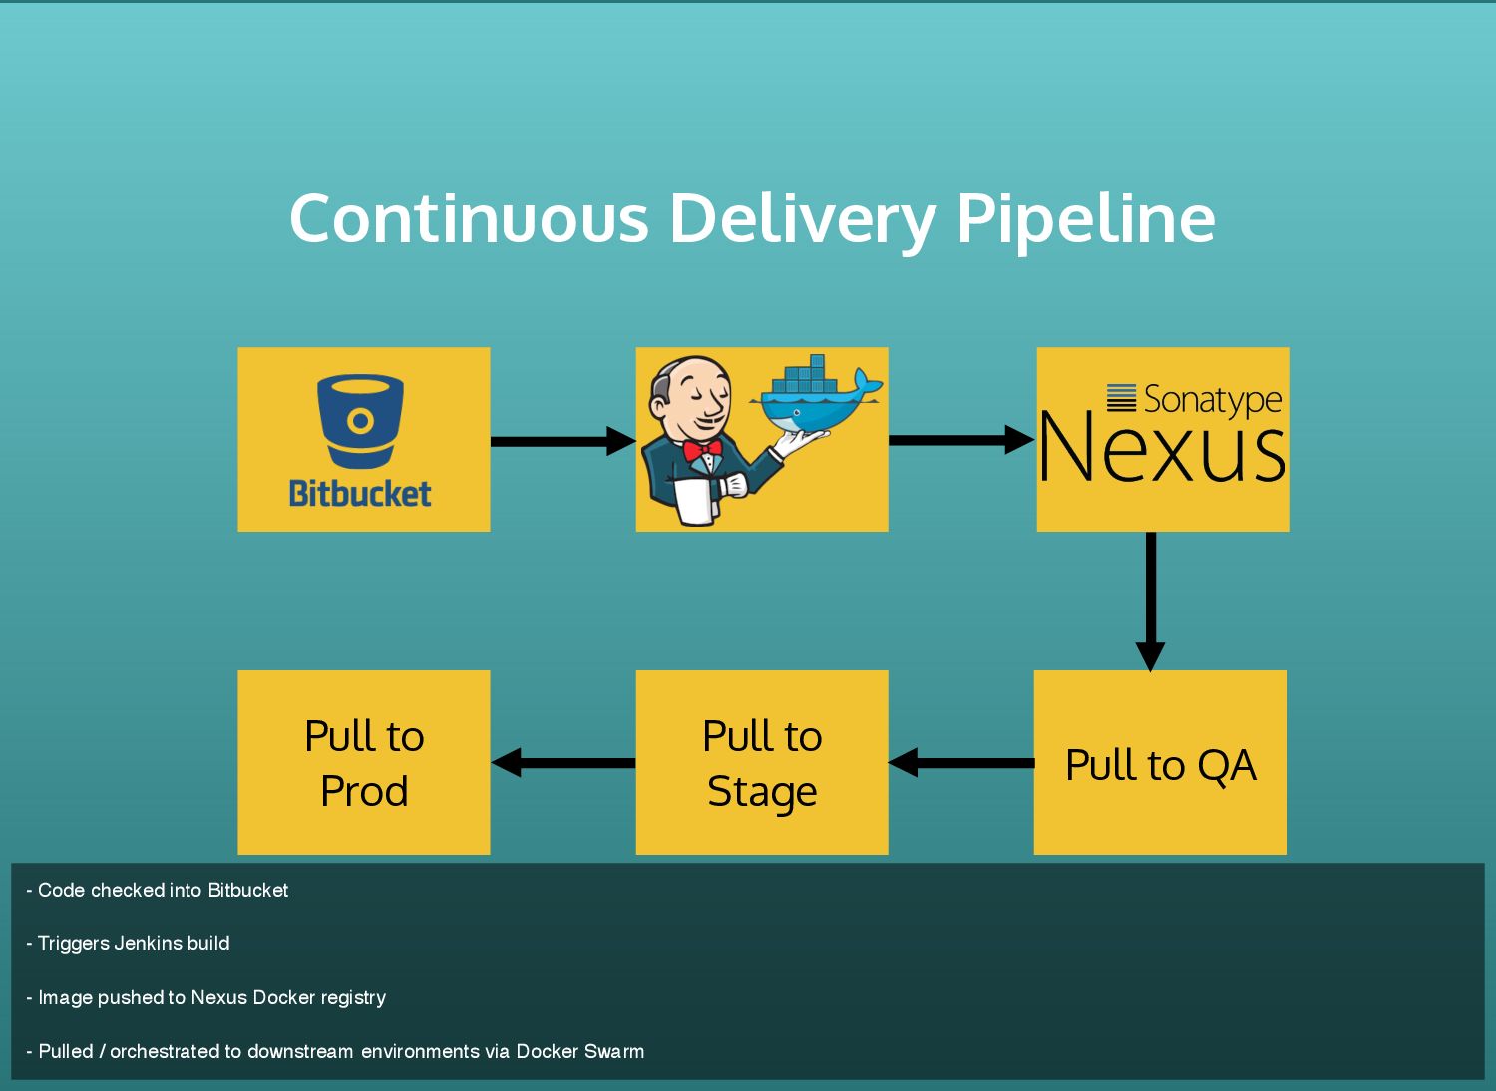

Slide 14
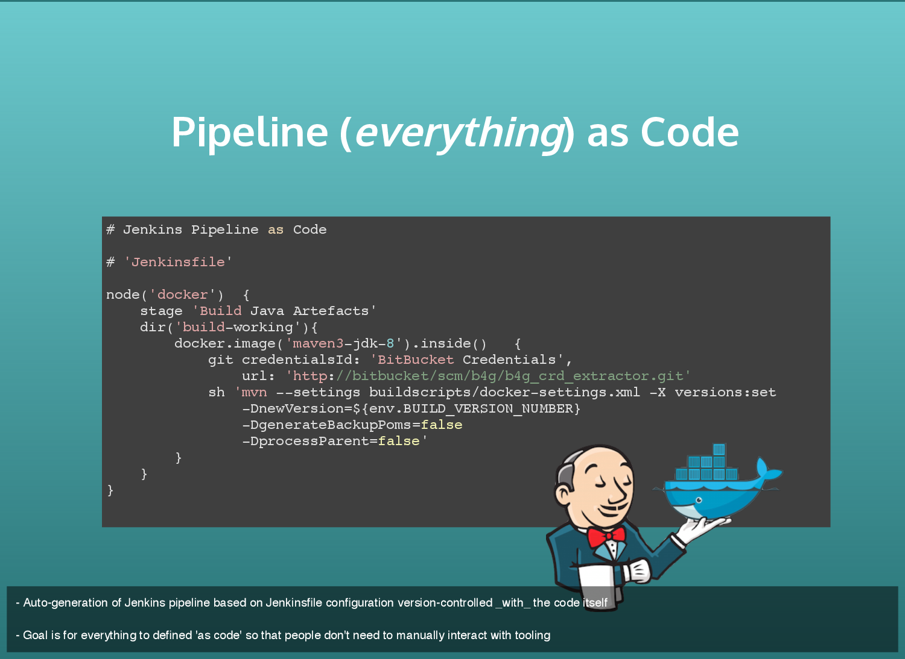

Slide 15
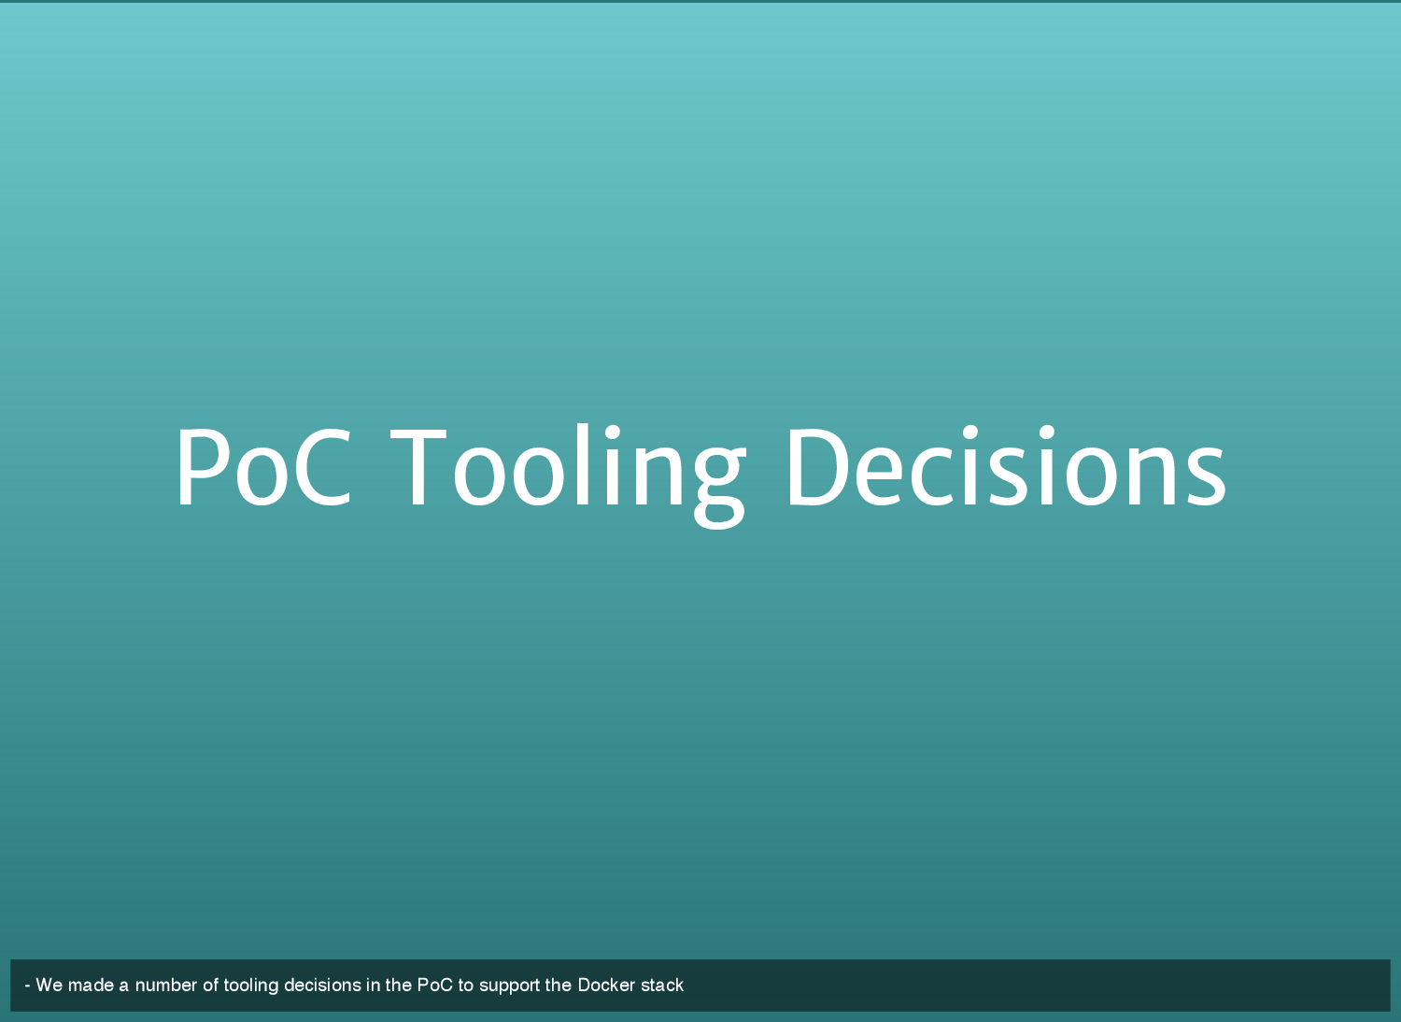
PoC Tools adopted

Slide 16
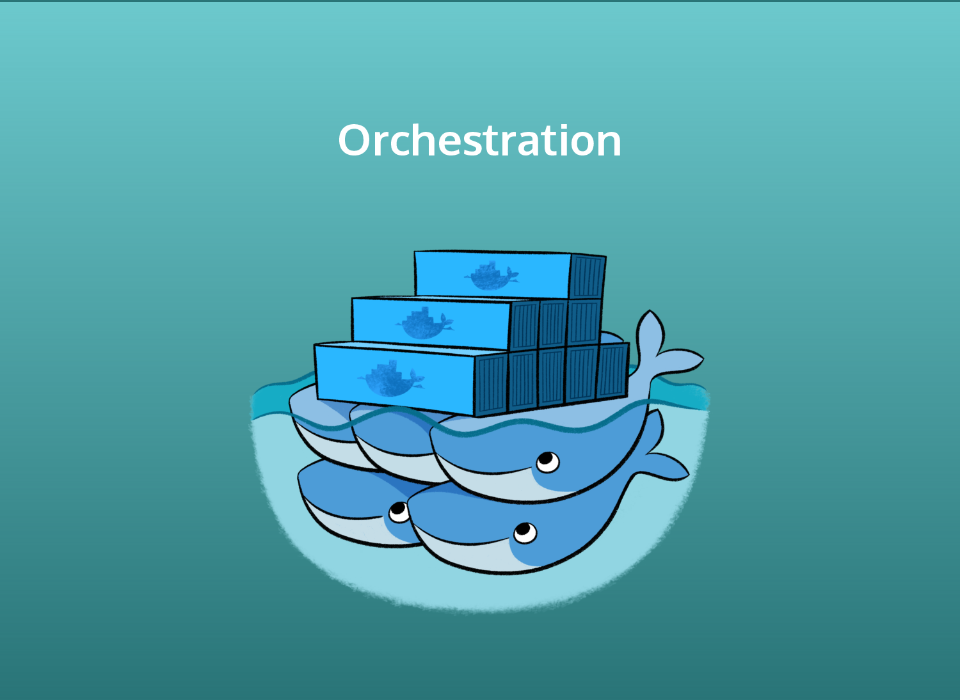

Slide 17
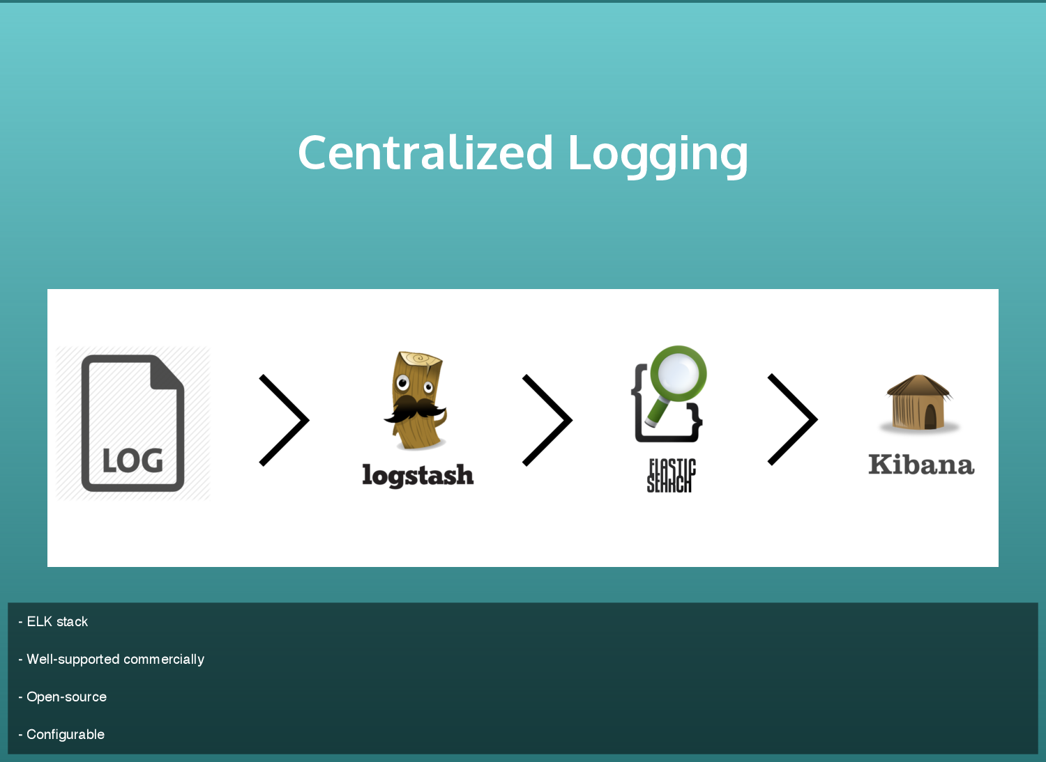

Slide 18
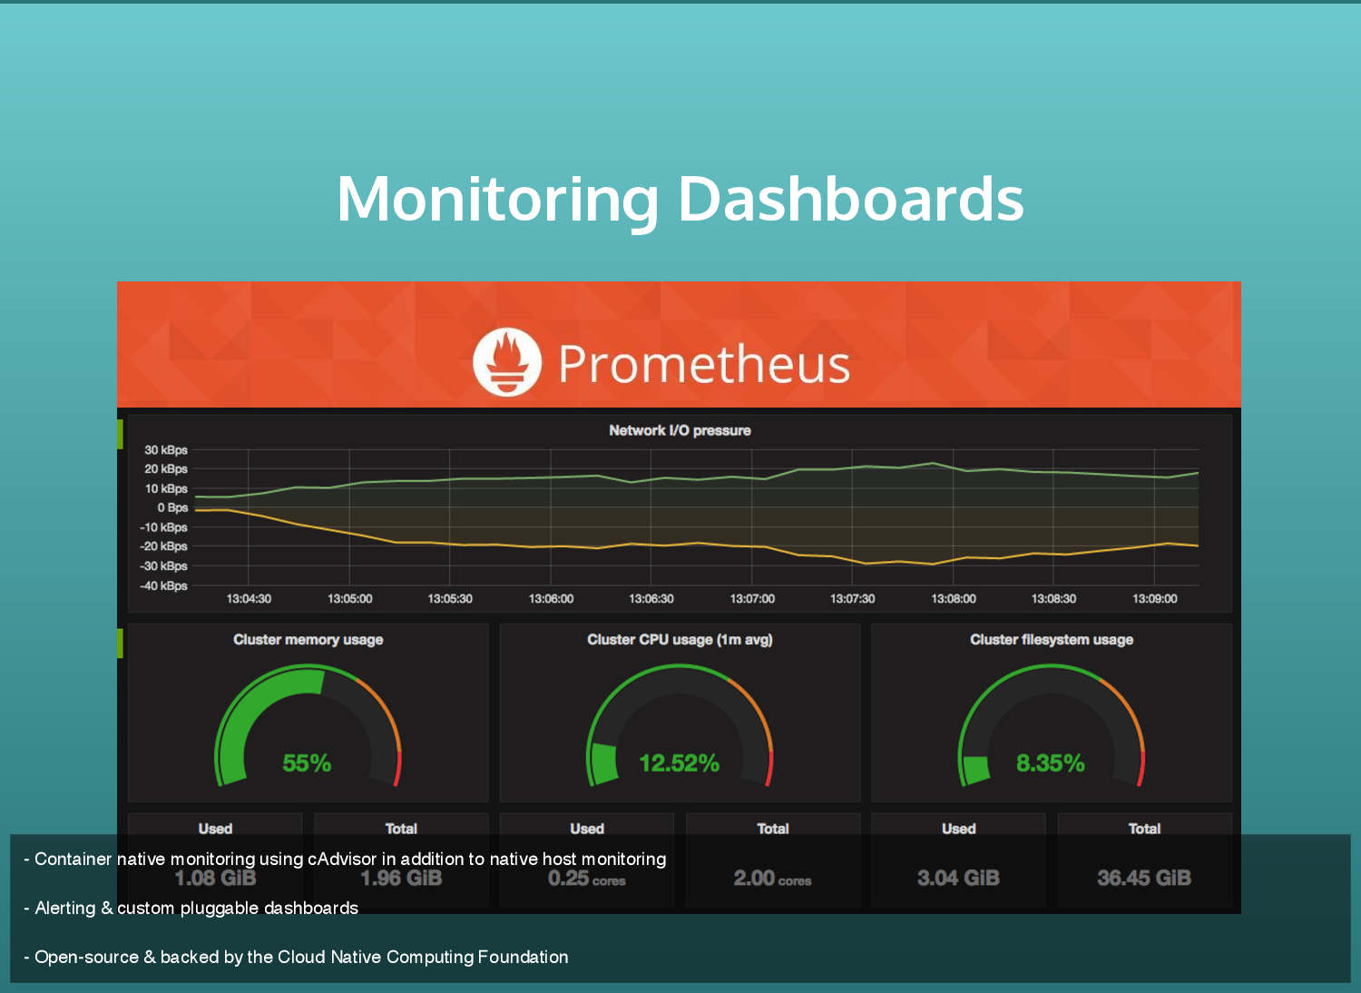

Slide 19
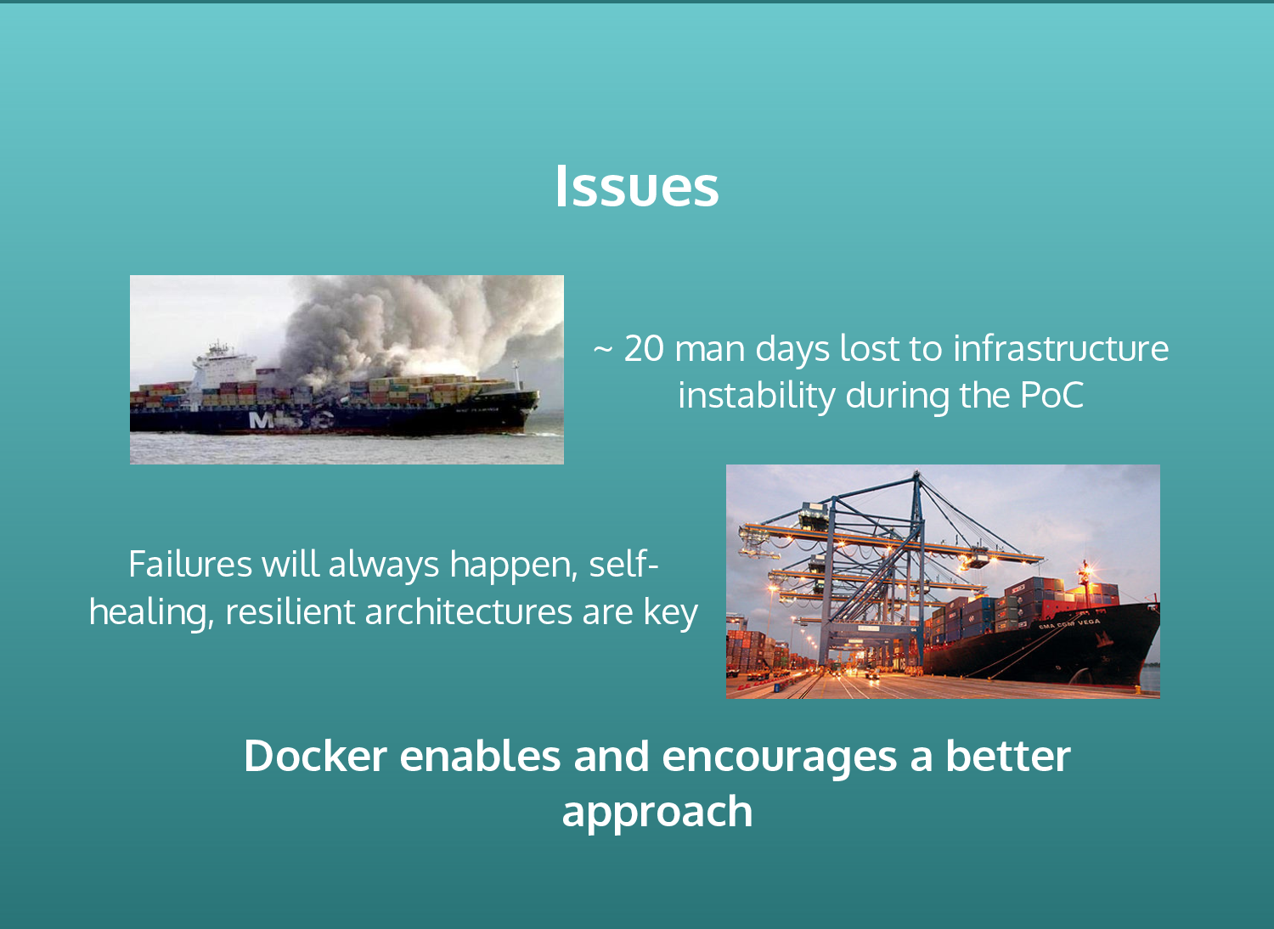
Discovery and opportunities to Improve

Slide 20
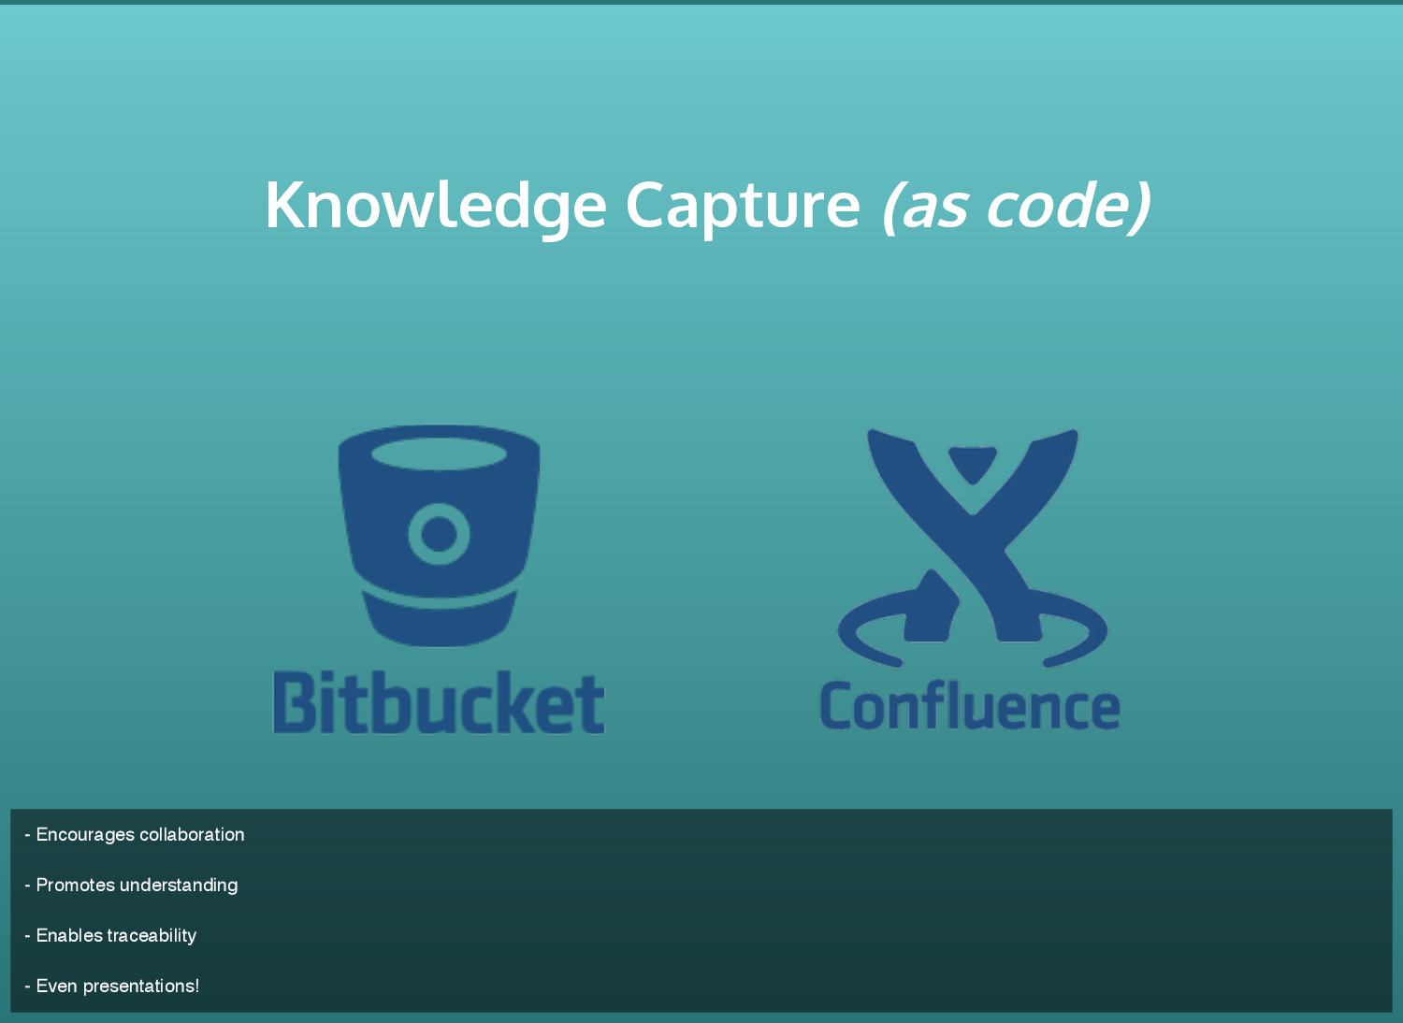

Slide 21
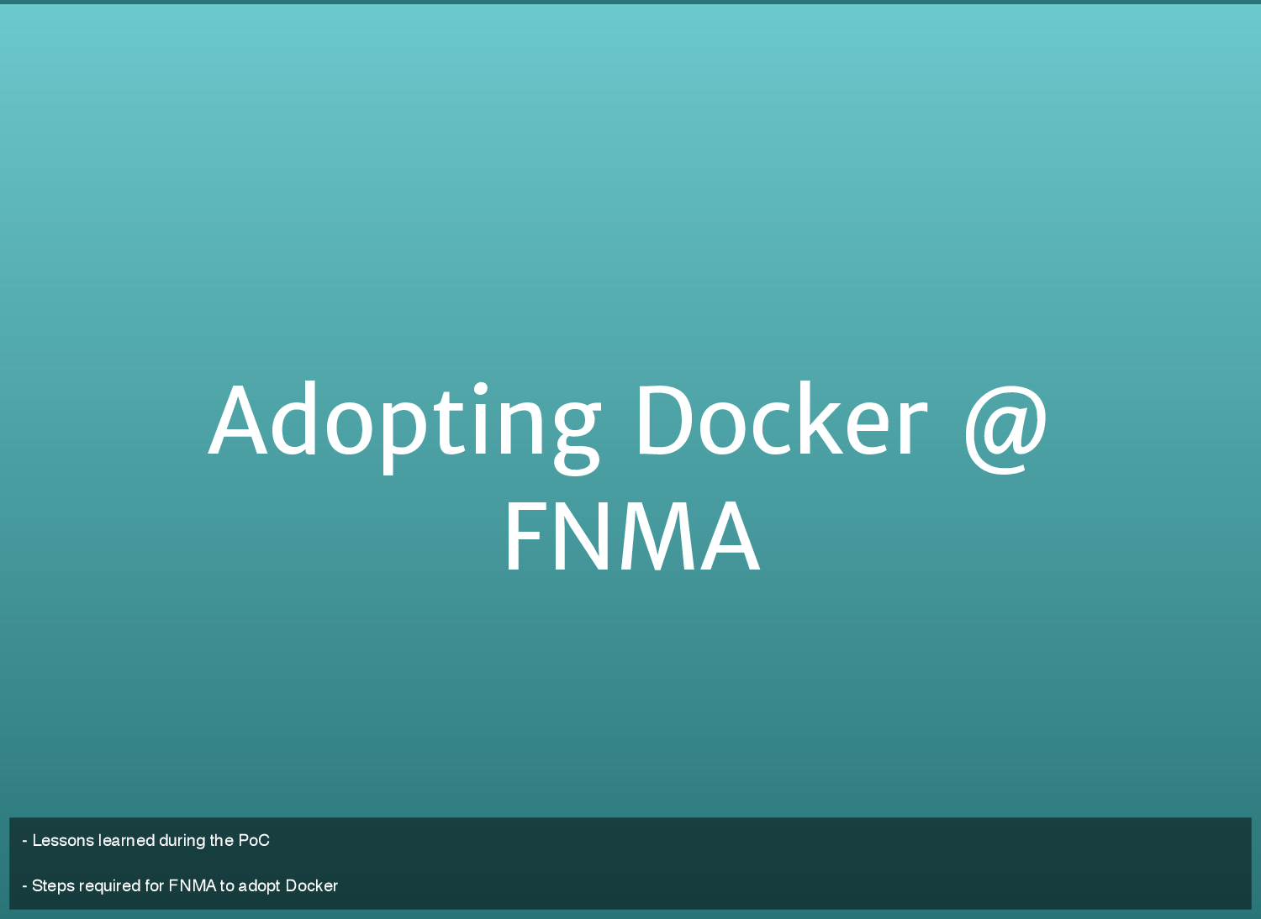

Slide 22
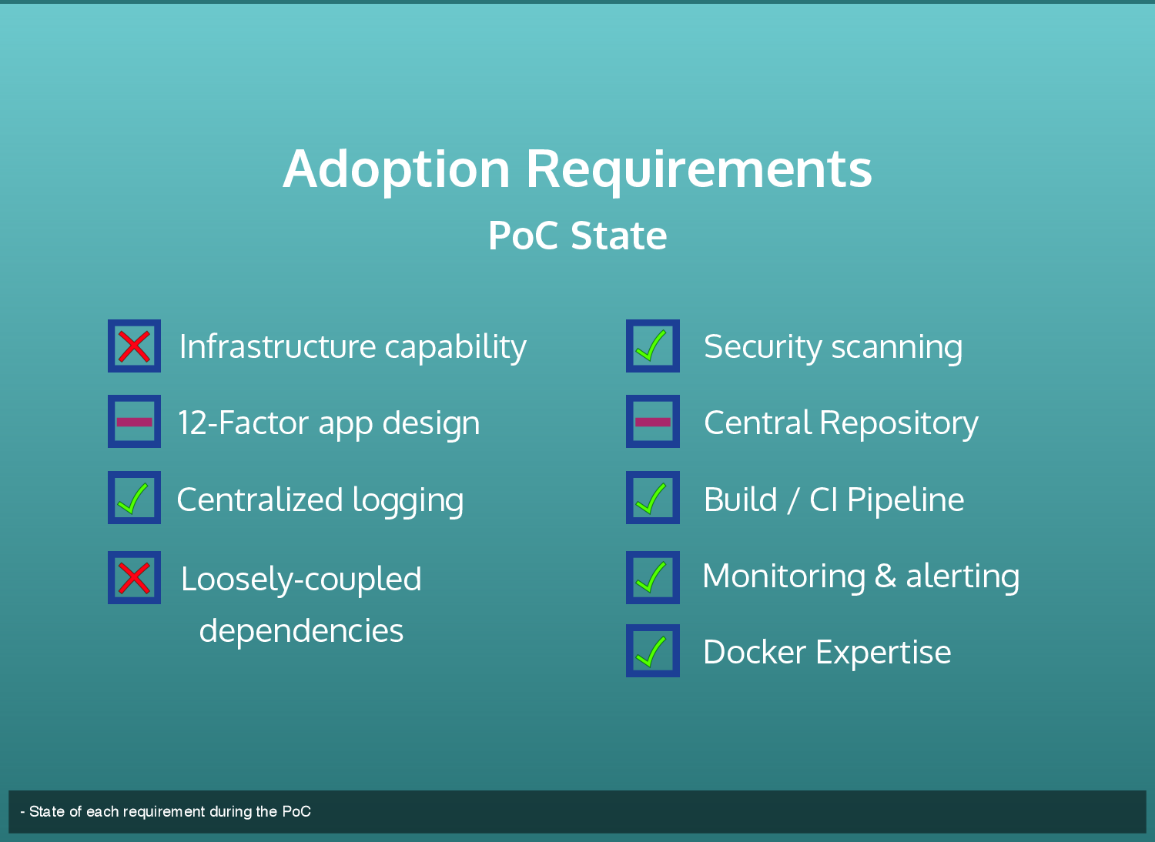

Slide 23
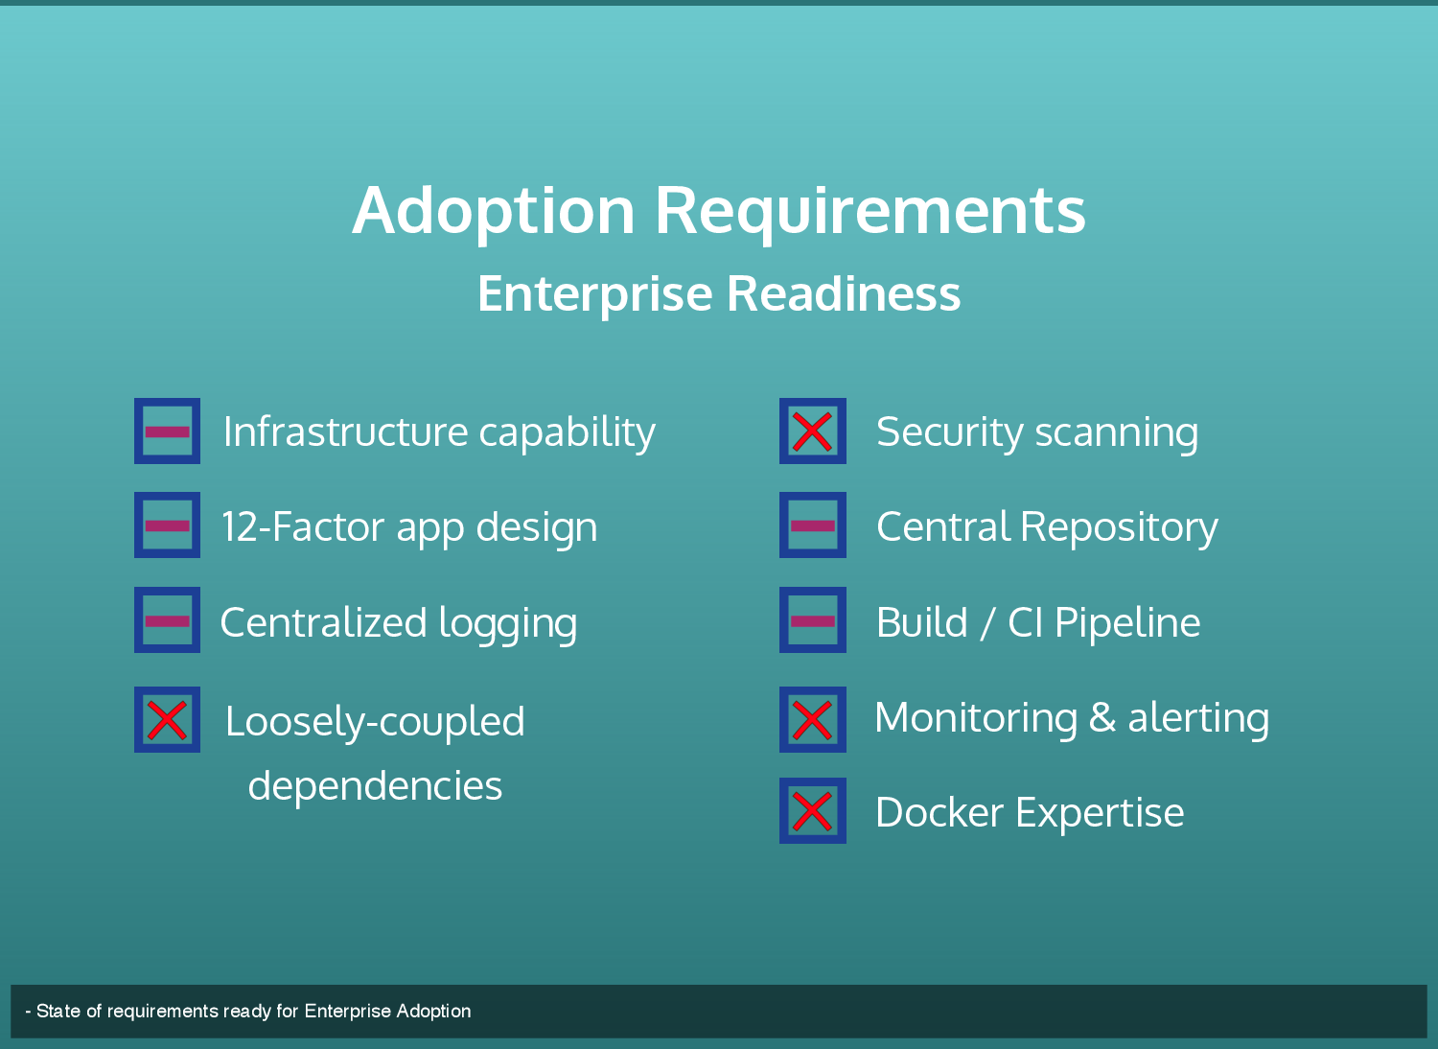

Slide 24
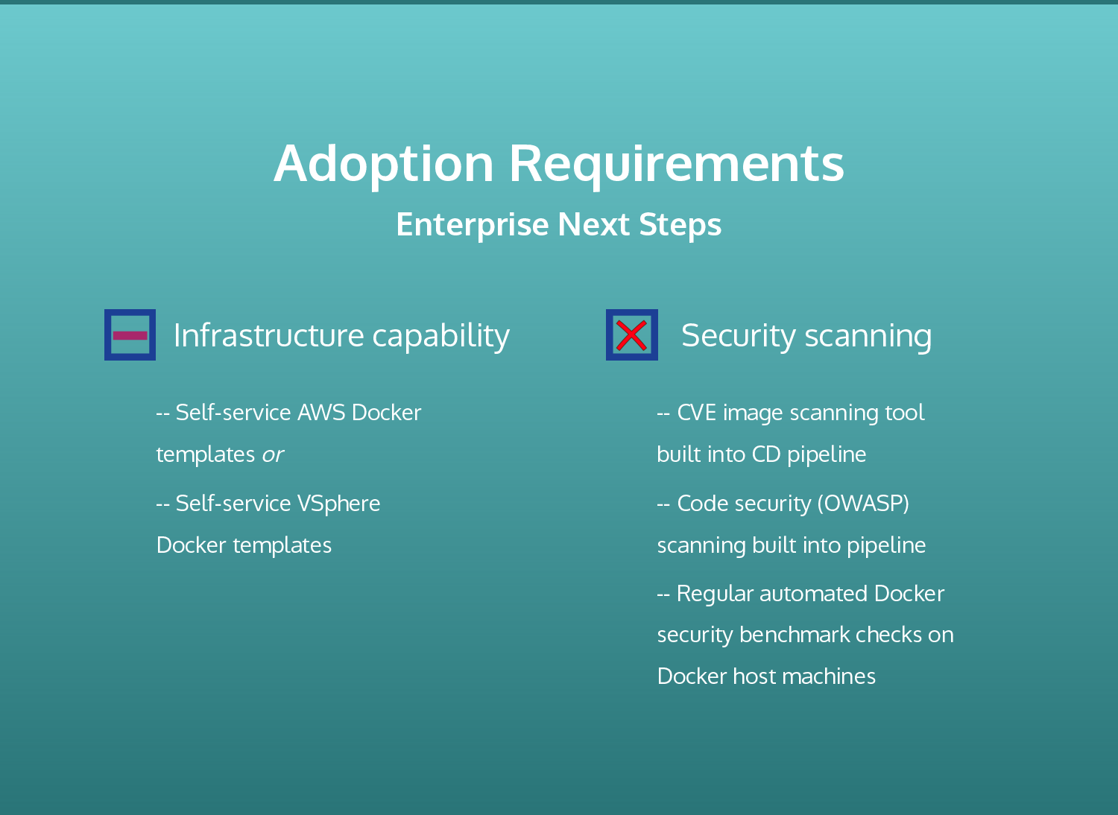

Slide 25
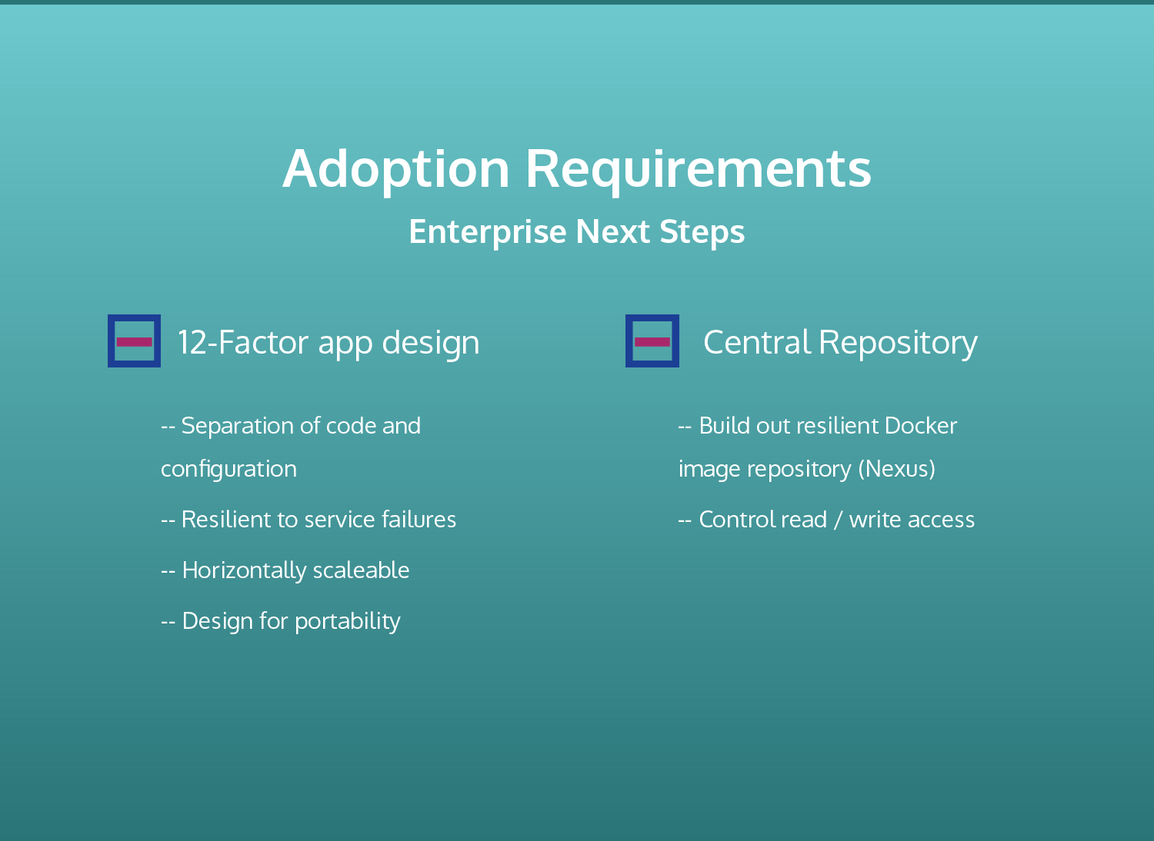

Slide 26
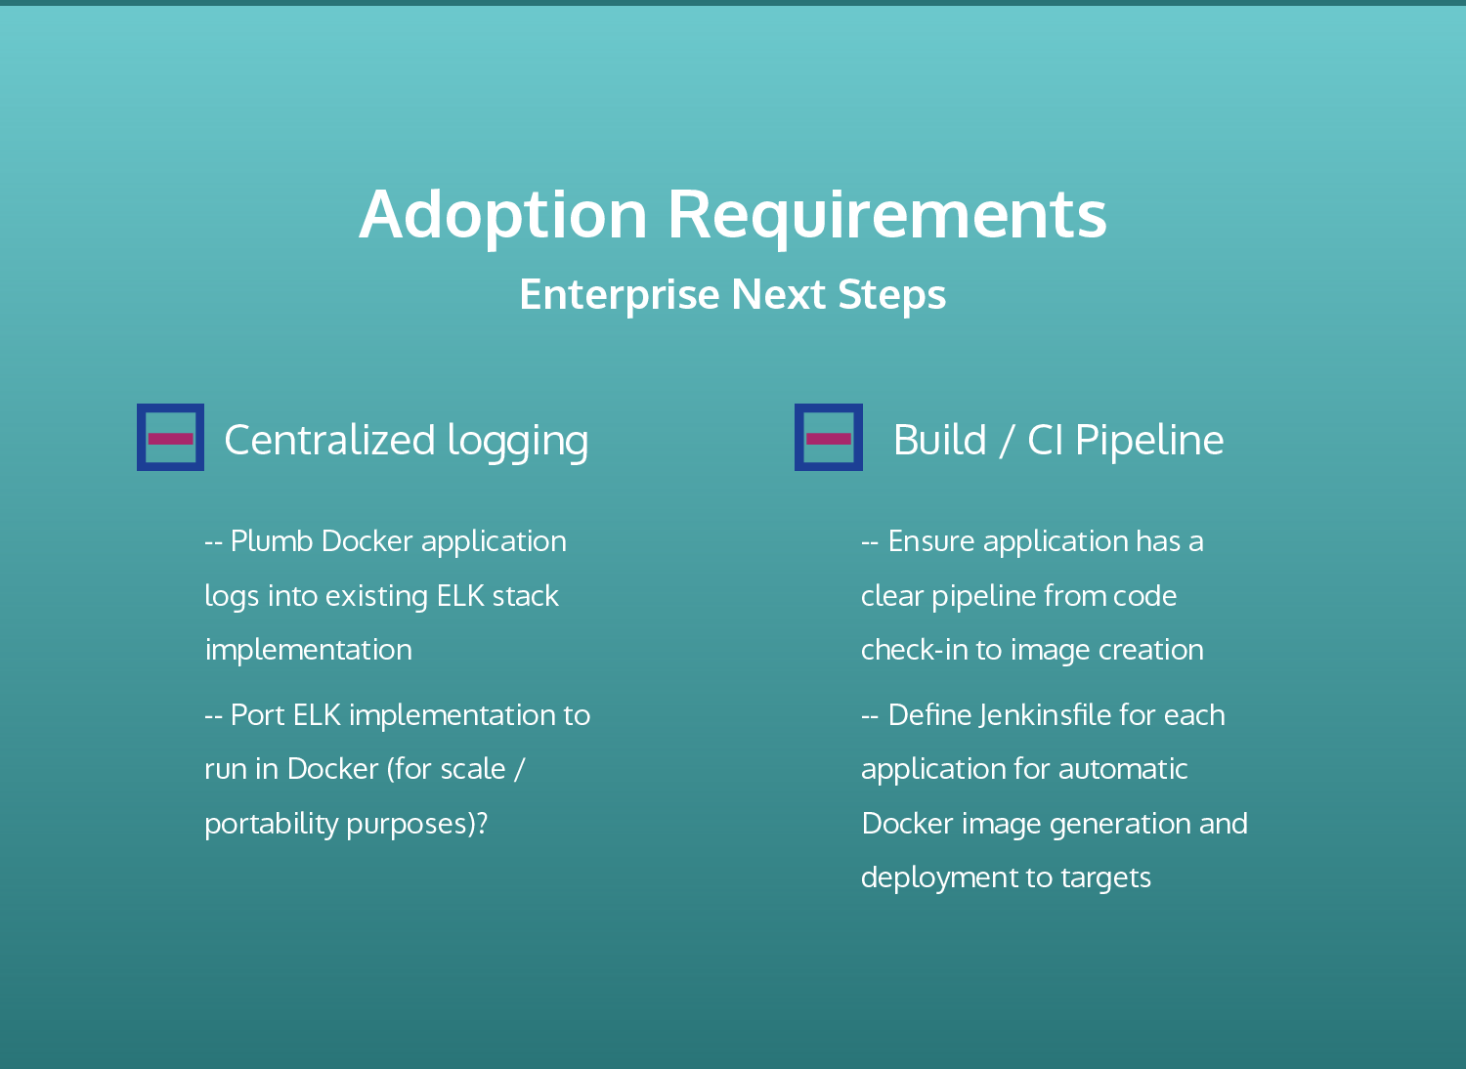

Slide 27
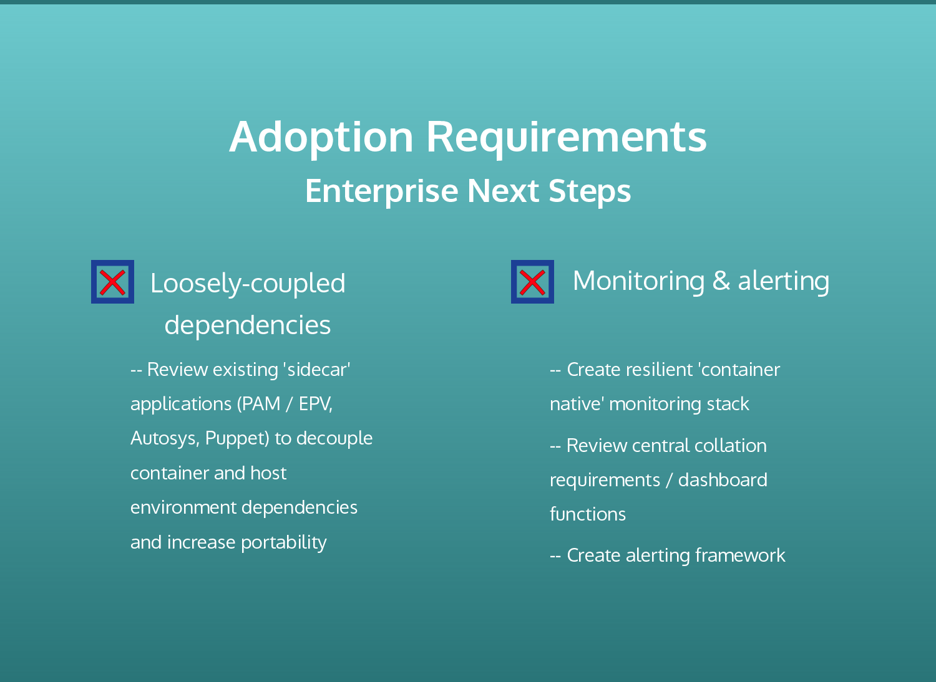

Slide 28
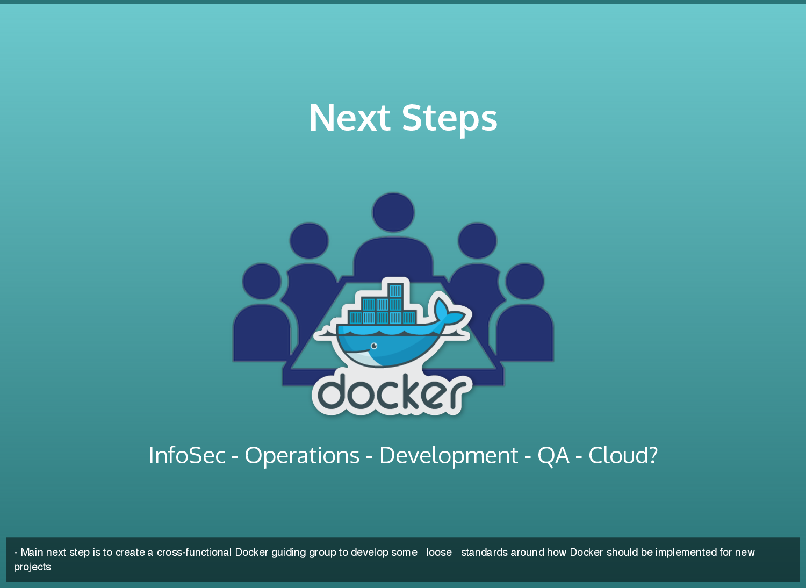

Slide 29
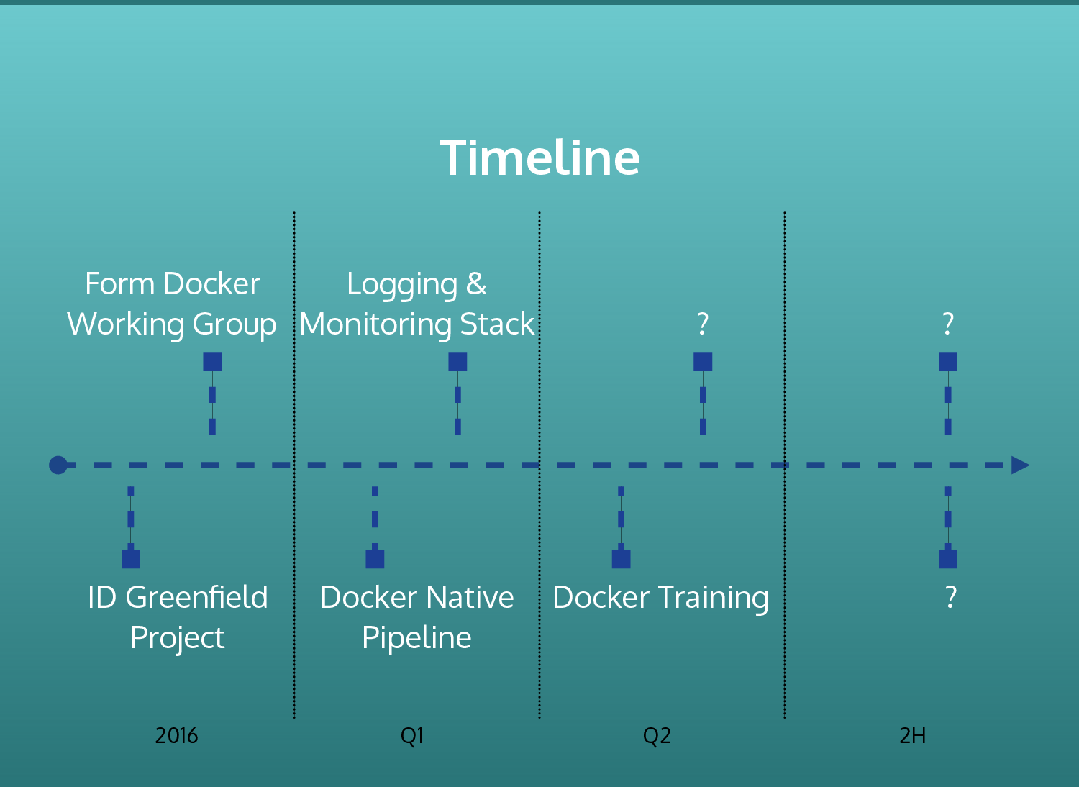

Slide 30


Slide 31
